Slide 1

How to write paper (1)?
---short paper

Slide 2

Sp
Paper is the article of Computer Science
New problem + Traditional Methods
Old problem + New Methods
New problem + New Methods
Old problem+ Traditional Methods + New results

Slide 3
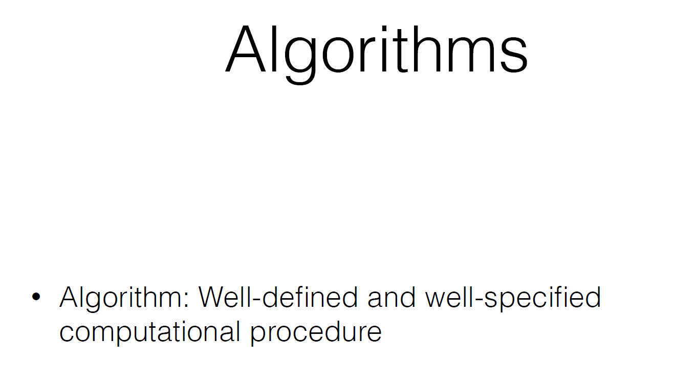
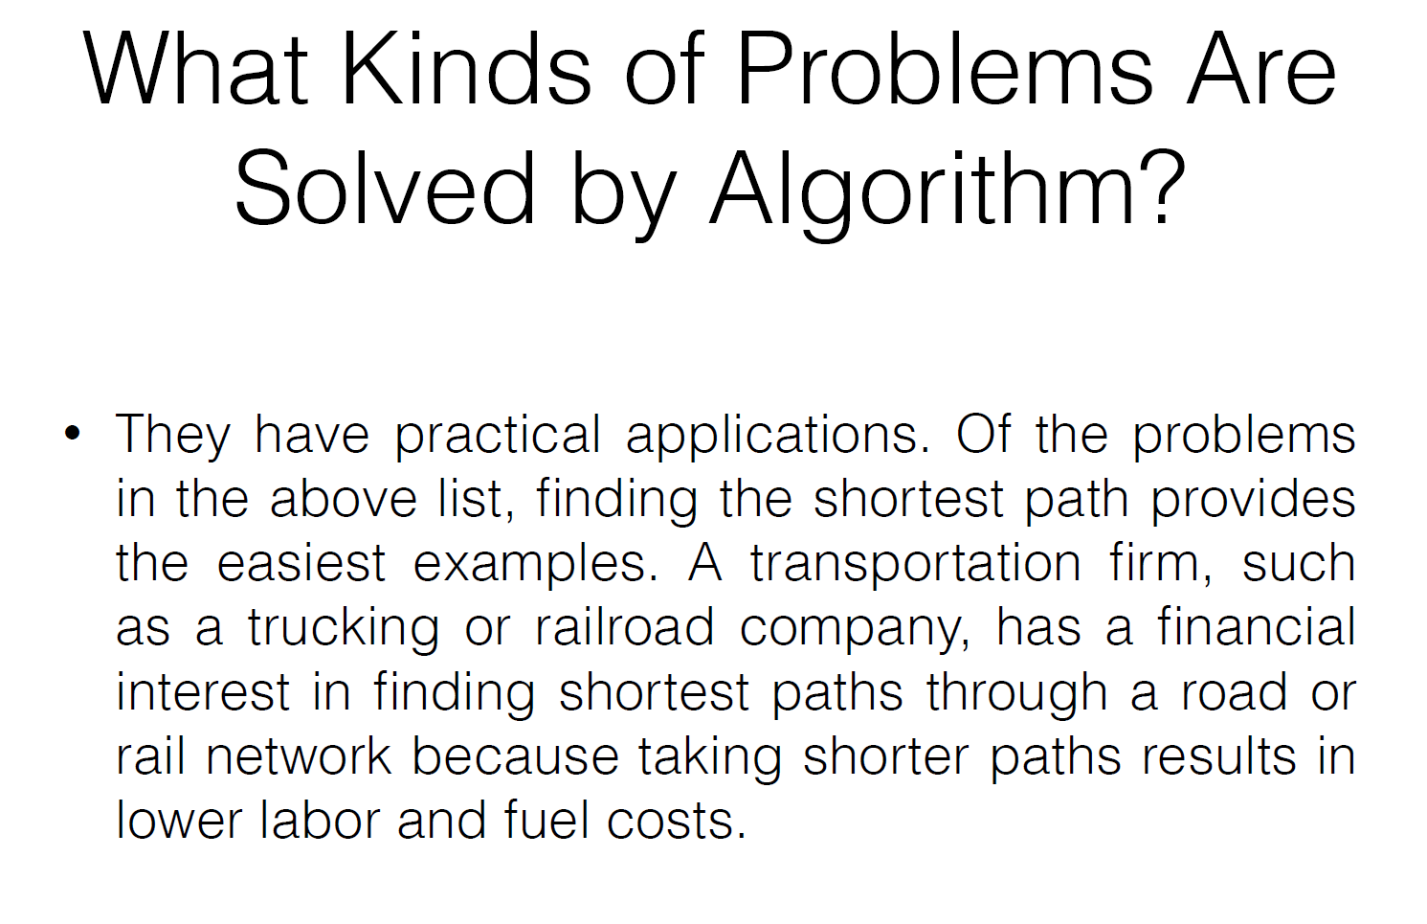
The structure of short paper
Abstract
Introduction
Preliminary
Your work
  New concepts
  Methods
  results
  Case study
Conclusion & future work
Reference

Slide 4
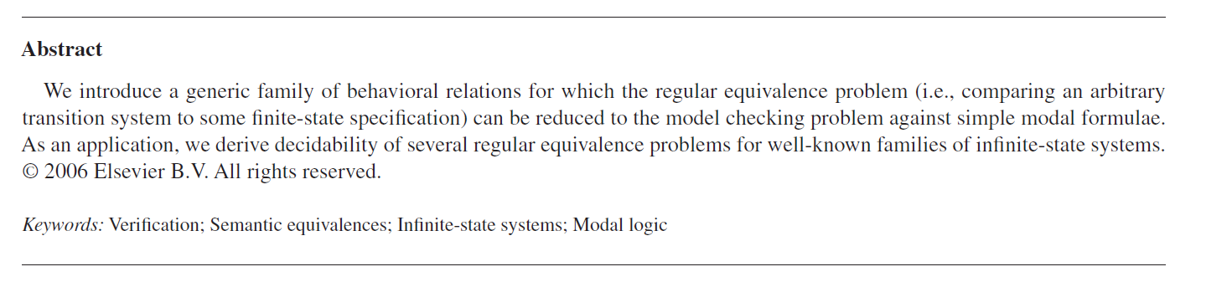
The
Abstract
The problem you solve
The technology you use
The results you get

Slide 5
Introduction
Which fields can be applied of your topics
What are the difficulties in these fields?
Related research results
Your idea

Slide 6
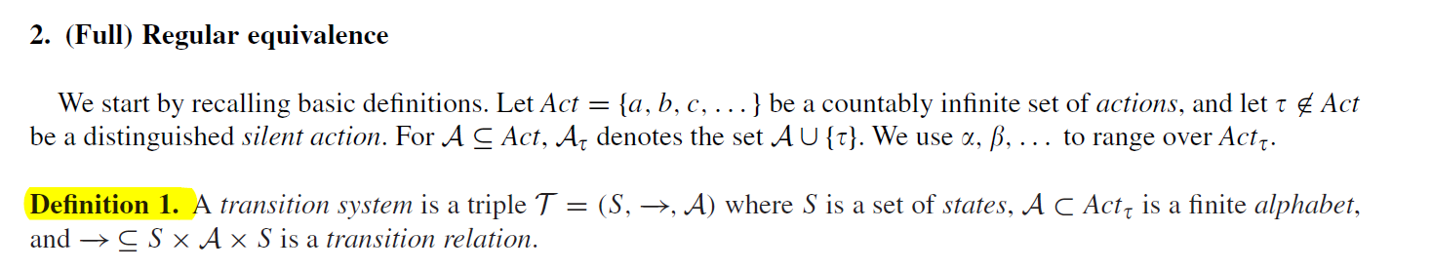
Preliminary
The concepts you will use
The properties you will use
The technology you will use
The results you will use

Slide 7
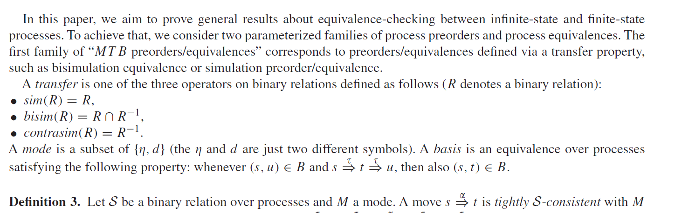
Your work---Main parts

Slide 8
Main
Main parts
Your new concepts
Your new methods
Your results
Comparison with other results (related work)

Slide 9
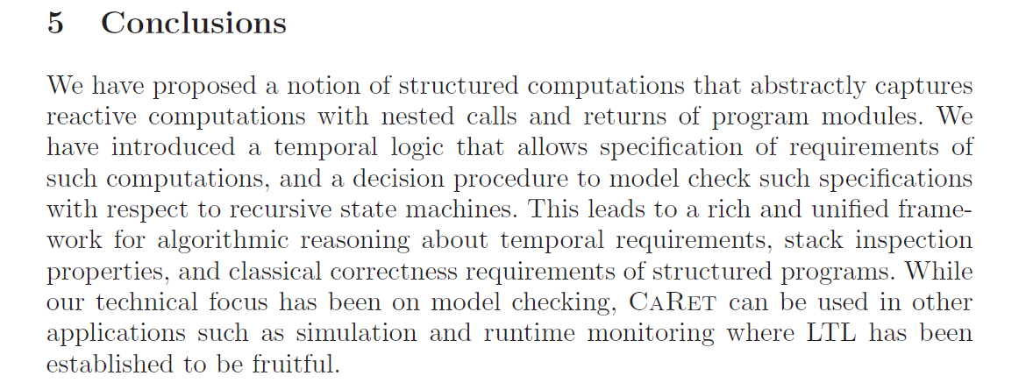
Main
Conclusion

Slide 10
Main
Conclusion
The News you give
  New concepts
  New technology
  New results
The potential applications

Slide 11
Other Comments
  Recite the beautiful sentences!

Slide 12
Team Show

